Slide 1
Background for class project: Interactive user-friendly management of Dusty runs
Astr 302, Winter 202

Slide 2
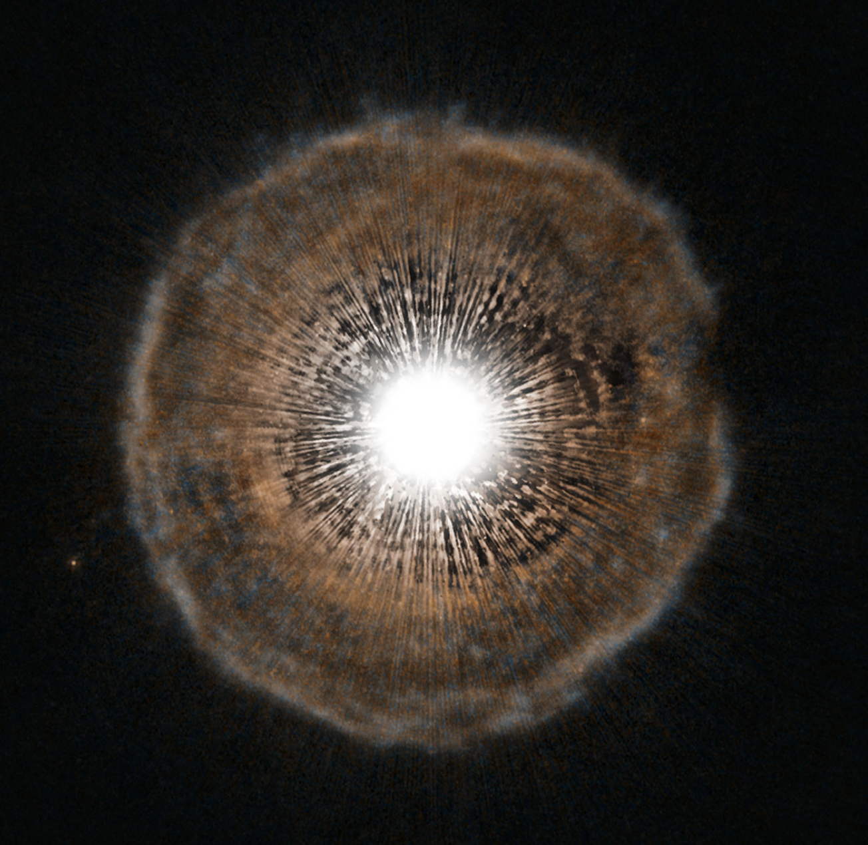
Some stars (very young and very old) are surrounded by circumstellar envelopes (or shells) made of gas and dust.
Dust absorbs radiation from the central star and reradiates it at longer (infrared: 1-100 mic) wavelengths.
The Dusty code solves a set of differential equations that describe these processes.

Slide 3
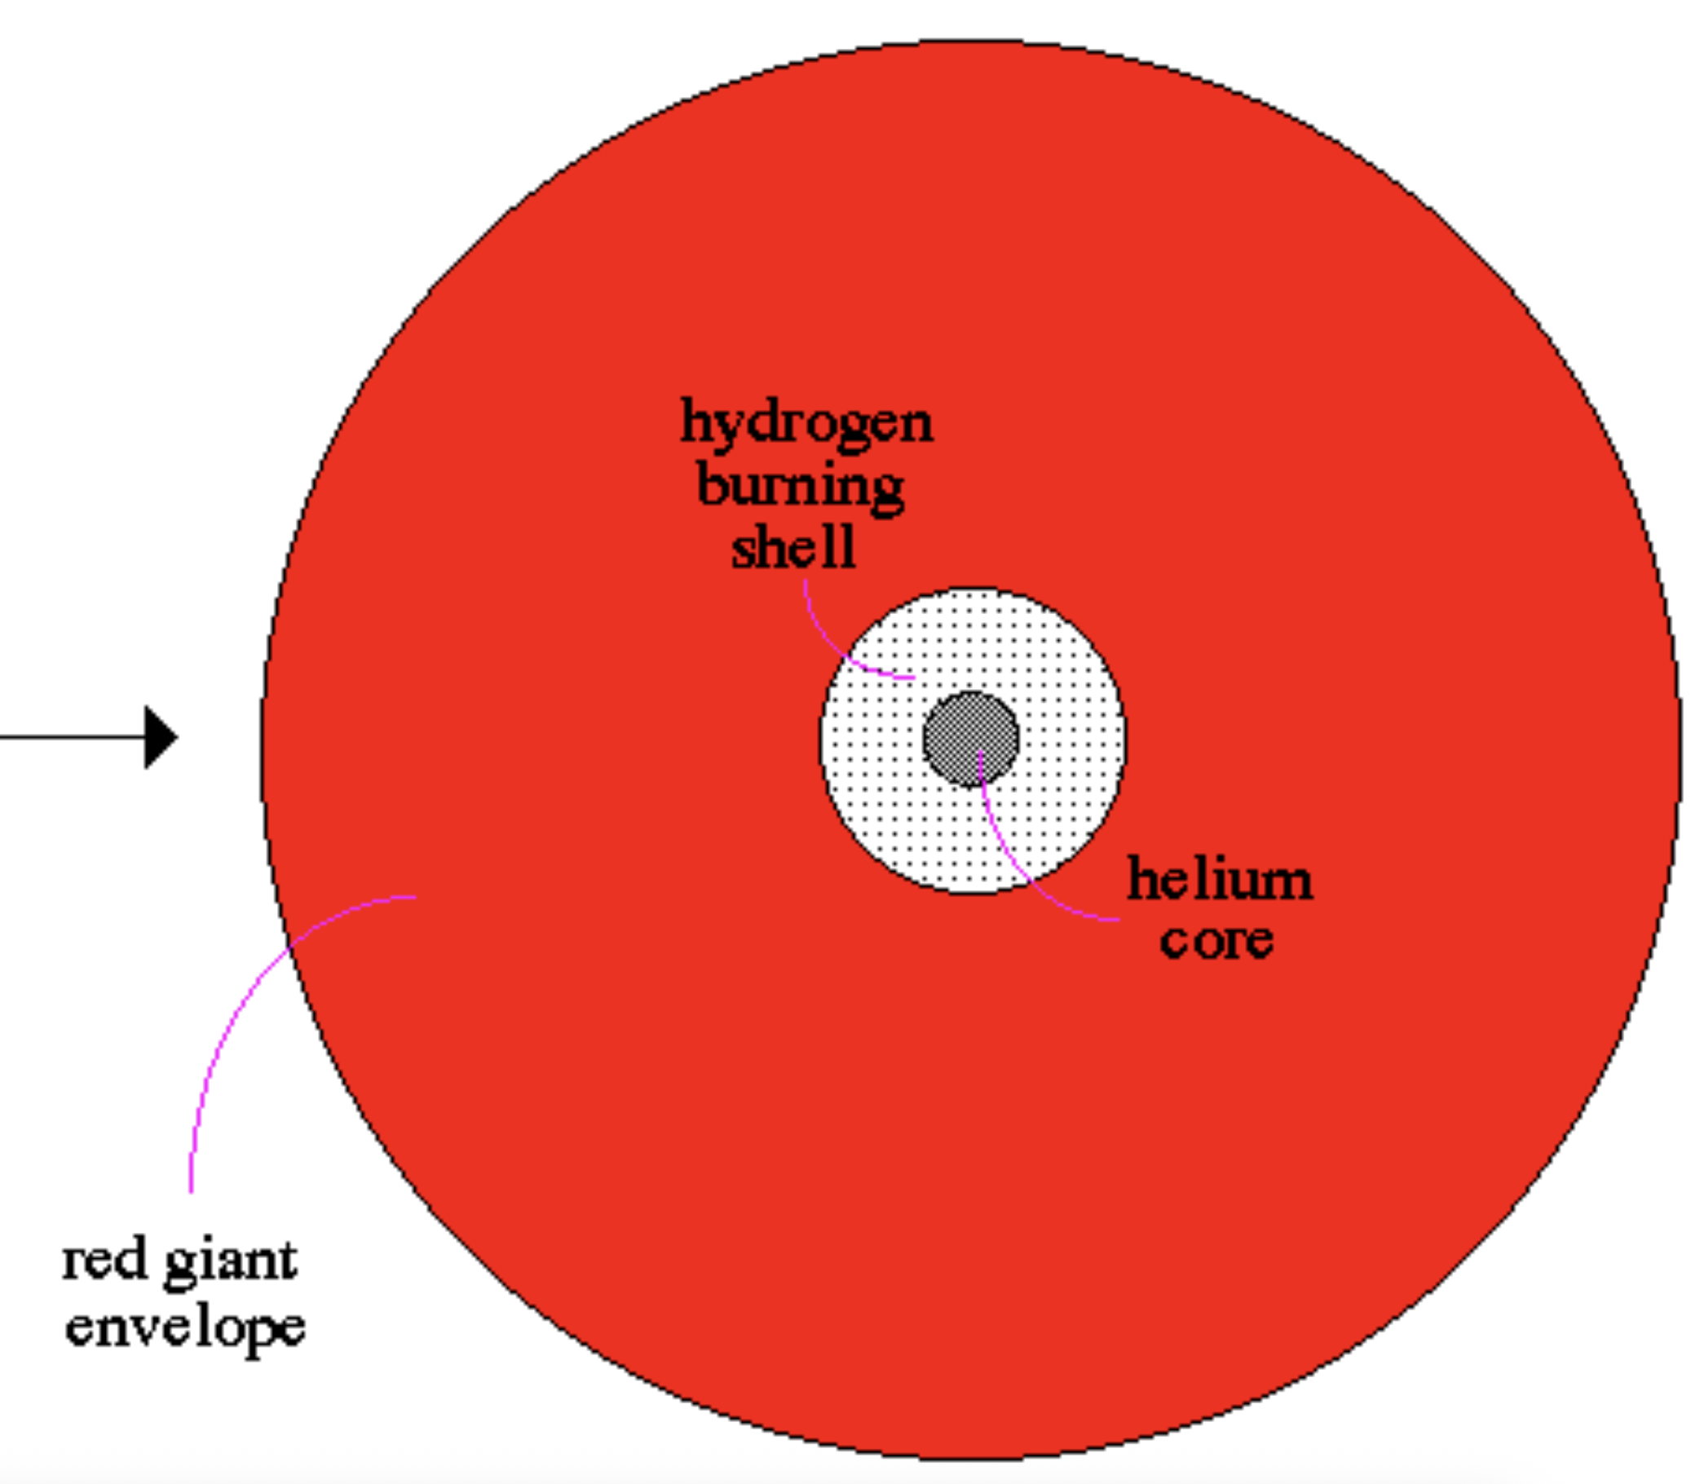
Star radiates isotropically (nearly as a black body)
Dust equilibrium temperature becomes equal to its sublimation temperature at the inner edge of the dust envelope.
Throughout the envelope, dust absorbs stellar radiation and reradiates it at longer wavelengths.
What we see is the surviving stellar radiation plus this reradiation from dust.
gaseous inner cavity
central star
dusty envelope

Slide 4
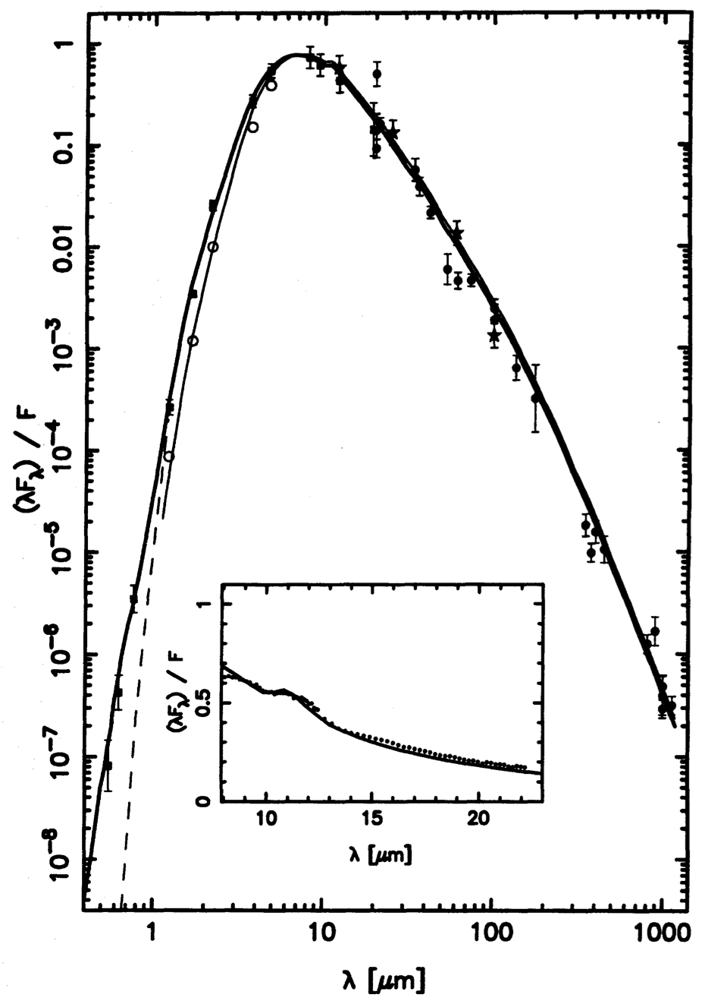
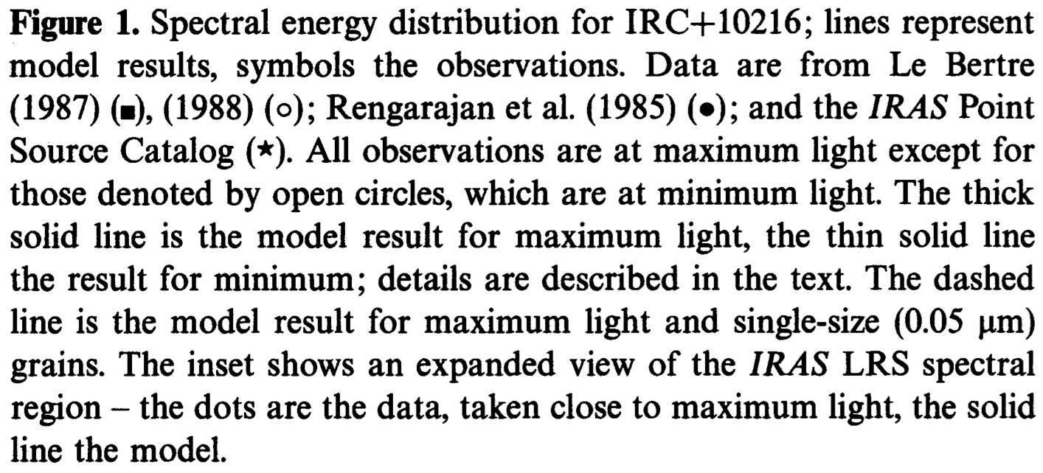
The most famous “infrared” star: CW Leo or IRC+10216. Note that its SED (spectral energy distribution) peaks around 10 mic (compare to the Sun: around 0.5 mic).
Its effective temperature (Wien’s law!) is about 3000 Kmic/10 mic ~ 300 K!

Slide 5
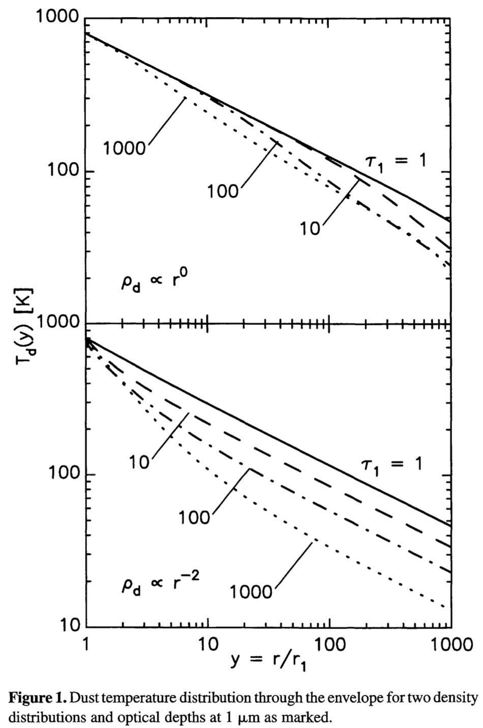
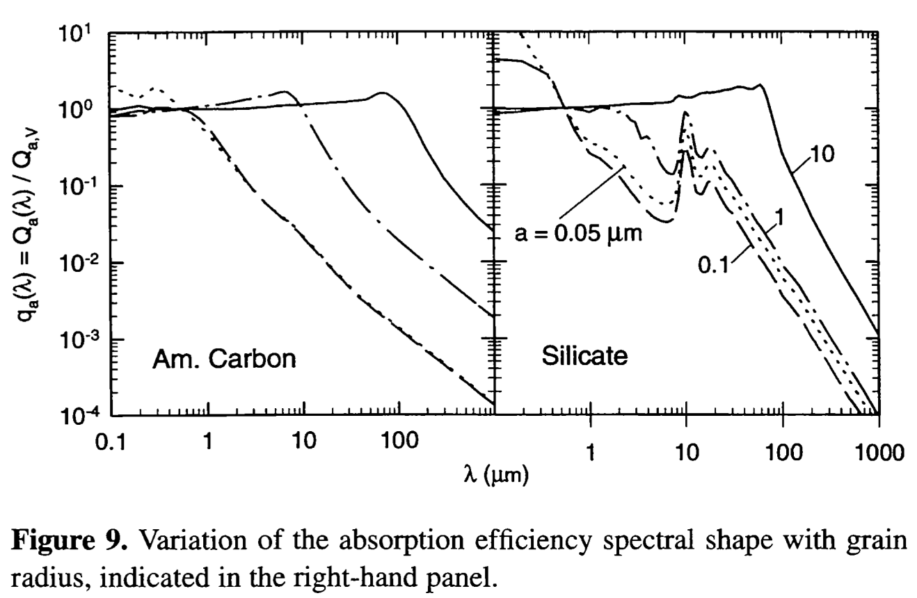
Dust temperature in the envelope varies from about 1000 K (sublimation temperature) to about 10 K (typically)

Slide 6
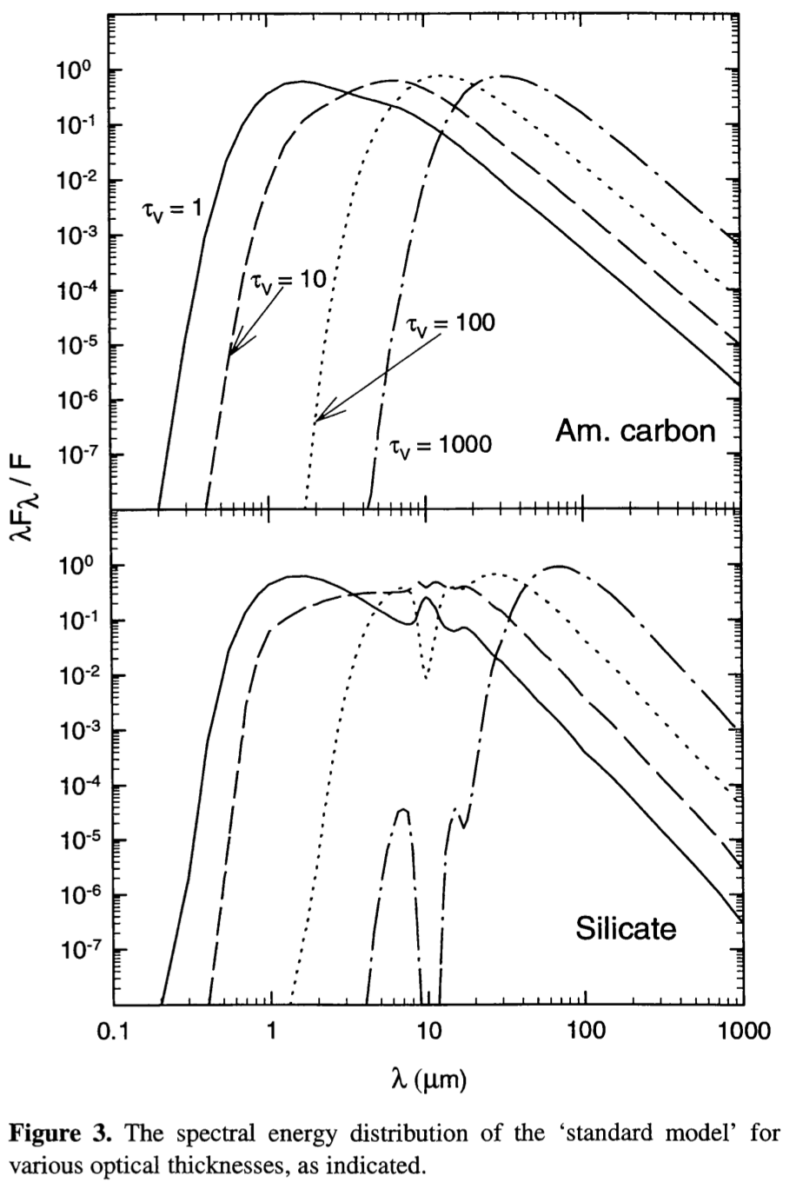
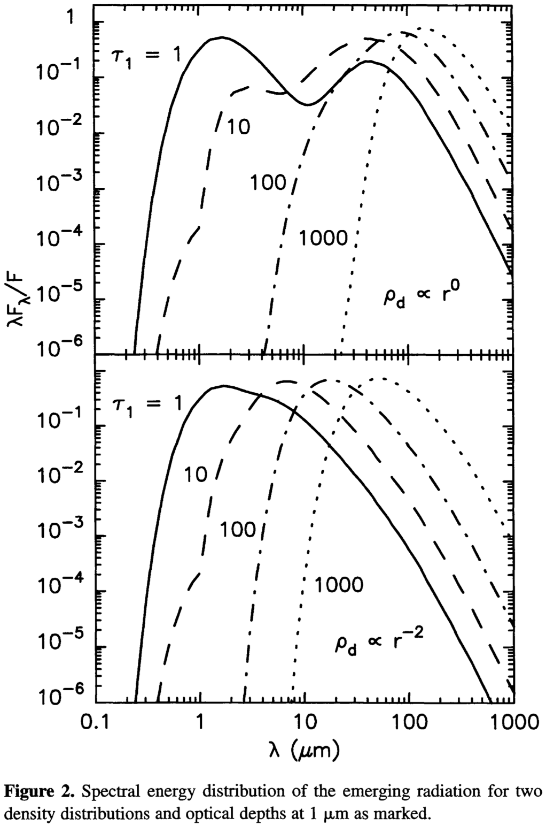

Slide 7
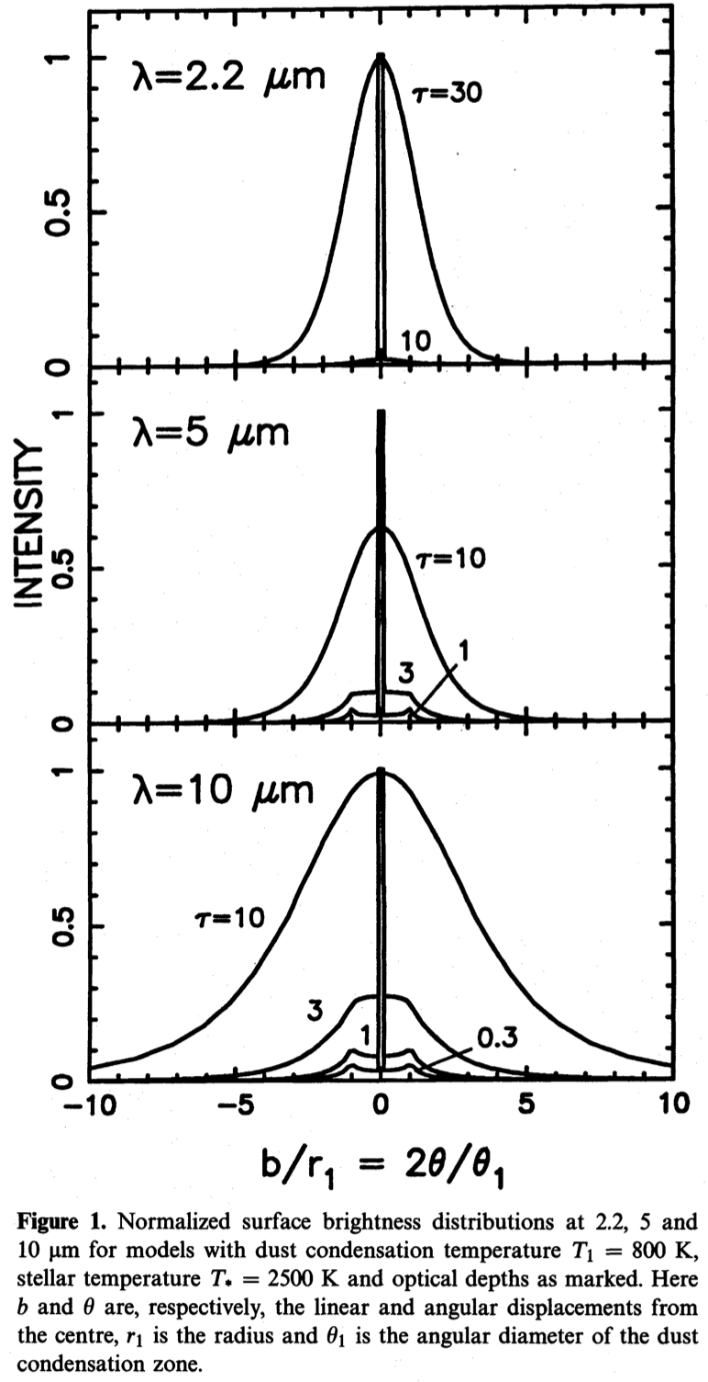
Dusty also computes intensity profiles (images).
Dusty assumes spherical geometry!

